Slide 1
50:50
14
13
12
11
10
9
8
7
6
5
4
3
2
1
£ 1 MILLION
£ 500,000
£ 250,000
£ 100,000
£ 50,000
£ 30,000
£ 20,000
£ 10,000
£ 3,000
£ 1,000
£ 400
£ 300
£ 200
£ 100
Who Wants To Be A
Millionaire?
LMI CAREERS EDUCATION
£ 100
What does LMI stand for?
Local Market Information
Labour Market Information
A:
B:
Local Movement Intelligence
Labour Measuring Inspiration
C:
D:

Slide 2
50:50
14
13
12
11
10
9
8
7
6
5
4
3
2
1
£ 1 MILLION
£ 500,000
£ 250,000
£ 100,000
£ 50,000
£ 30,000
£ 20,000
£ 10,000
£ 3,000
£ 1,000
£ 400
£ 300
£ 200
£ 100
Learning objectives
Find out what LMI is
Discover why it is important
Learn how you can use it
Find sources of LMI that you can use
£ 100
What does LMI stand for?
LMI CAREERS EDUCATION
Local Market Information
Labour Market Information
A:
B:
Local Movement Intelligence
Labour Measuring Inspiration
C:
D:

Slide 3
50:50
7
6
5
4
3
2
1
£ 1 MILLION
£ 500,000
£ 250,000
£ 100,000
£ 50,000
£ 30,000
£ 20,000
£ 10,000
£ 3,000
£ 1,000
£ 400
£ 300
£ 200
£ 100
Question 1
£ 100
What does LMI stand for?
LMI CAREERS EDUCATION
Local Market Information
Labour Market Information
A:
B:
Local Movement Intelligence
Labour Measuring Inspiration
Find out what LMI is
Discover why it is important
Learn how you can use it
Find sources of LMI that you can use
C:
D:

Slide 4
50:50
14
13
12
11
10
9
8
7
6
5
4
3
2
1
£ 1 MILLION
£ 500,000
£ 250,000
£ 100,000
£ 50,000
£ 30,000
£ 20,000
£ 10,000
£ 3,000
£ 1,000
£ 400
£ 300
£ 200
£ 100
£ 100
What does LMI stand for?
Local Market Information
Labour Market Information
A:
B:
Local Movement Intelligence
Labour Measuring Inspiration
C:
D:
LMI CAREERS EDUCATION
Find out what LMI is
Discover why it is important
Learn how you can use it
Find sources of LMI that you can use
Question 1

Slide 5
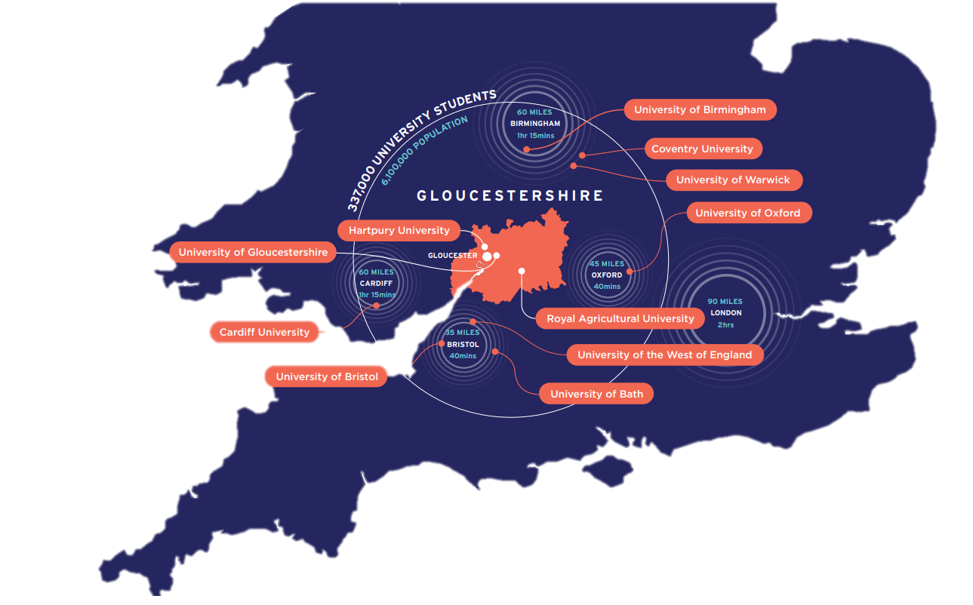
Labour Market Information
50:50
14
13
12
11
10
9
8
7
6
5
4
3
2
1
£ 1 MILLION
£ 500,000
£ 250,000
£ 100,000
£ 50,000
£ 30,000
£ 20,000
£ 10,000
£ 3,000
£ 1,000
£ 400
£ 300
£ 200
£ 100
Labour Market Information (LMI) is the name for facts and figures about jobs and employment.
The information is used to give an overall picture of the past, present and future of work.
The labour market is the term used to describe the amount of people working and looking for work, and the amount of jobs.
£ 100
What does LMI stand for?
LMI can help you understand:
What a job involves on a day-to-day basis
Which jobs are growing or declining and which might exist in the future
What qualifications or skills you might need to do a job
How much you might earn
How your interests and skills are relevant to particular jobs
What jobs there are in your county or region
Local Market Information
Labour Market Information
A:
B:
Local Movement Intelligence
Labour Measuring Inspiration
C:
D:
LMI CAREERS EDUCATION
Find out what LMI is
Discover why it is important
Learn how you can use it
Find sources of LMI that you can use
Question 1

Slide 6
50:50
Labour Market Information
14
13
12
11
10
9
8
7
6
5
4
3
2
1
£ 1 MILLION
£ 500,000
£ 250,000
£ 100,000
£ 50,000
£ 30,000
£ 20,000
£ 10,000
£ 3,000
£ 1,000
£ 400
£ 300
£ 200
£ 100
Labour Market Information (LMI) is the name for facts and figures about jobs and employment.
The information is used to give an overall picture of the past, present and future of work.
The labour market is the term used to describe the amount of people working and looking for work, and the amount of jobs.
LMI can help you understand:
What a job involves on a day-to-day basis
Which jobs are growing or declining and which might exist in the future
What qualifications or skills you might need to do a job
How much you might earn
How your interests and skills are relevant to particular jobs
What jobs there are in your county or region
£ 100
What does LMI stand for?
LMI CAREERS EDUCATION
Local Market Information
Labour Market Information
A:
B:
Find out what LMI is
Discover why it is important
Learn how you can use it
Find sources of LMI that you can use
Local Movement Intelligence
Labour Measuring Inspiration
C:
D:
Question 1

Slide 7
Labour Market Information
50:50
7
6
5
4
3
2
1
£ 1 MILLION
£ 500,000
£ 250,000
£ 100,000
£ 50,000
£ 30,000
£ 20,000
£ 10,000
£ 3,000
£ 1,000
£ 400
£ 300
£ 200
£ 100
Labour Market Information (LMI) is the name for facts and figures about jobs and employment.
The information is used to give an overall picture of the past, present and future of work.
The labour market is the term used to describe the amount of people working and looking for work, and the amount of jobs.
Question 2
LMI can help you understand:
What a job involves on a day-to-day basis
Which jobs are growing or declining and which might exist in the future
What qualifications or skills you might need to do a job
How much you might earn
How your interests and skills are relevant to particular jobs
What jobs there are in your county or region
£ 200
In the future it is predicted that more jobs will require:
LMI CAREERS EDUCATION
More manual labour
Less IT skills
A:
B:
Find out what LMI is
Discover why it is important
Learn how you can use it
Find sources of LMI that you can use
Lower skills levels
Higher Skills levels
C:
D:

Slide 8
Labour Market Information
50:50
14
13
12
11
10
9
8
7
6
5
4
3
2
1
£ 1 MILLION
£ 500,000
£ 250,000
£ 100,000
£ 50,000
£ 30,000
£ 20,000
£ 10,000
£ 3,000
£ 1,000
£ 400
£ 300
£ 200
£ 100
Labour Market Information (LMI) is the name for facts and figures about jobs and employment.
The information is used to give an overall picture of the past, present and future of work.
The labour market is the term used to describe the amount of people working and looking for work, and the amount of jobs.
£ 200
In the future it is predicted that more jobs will require:
LMI can help you understand:
What a job involves on a day-to-day basis
Which jobs are growing or declining and which might exist in the future
What qualifications or skills you might need to do a job
How much you might earn
How your interests and skills are relevant to particular jobs
What jobs there are in your county or region
More manual labour
Less IT skills
A:
B:
Lower skills levels
Higher Skills levels
C:
D:
LMI CAREERS EDUCATION
Find out what LMI is
Discover why it is important
Learn how you can use it
Find sources of LMI that you can use
Question 2

Slide 9
Labour Market Information
50:50
14
13
12
11
10
9
8
7
6
5
4
3
2
1
£ 1 MILLION
£ 500,000
£ 250,000
£ 100,000
£ 50,000
£ 30,000
£ 20,000
£ 10,000
£ 3,000
£ 1,000
£ 400
£ 300
£ 200
£ 100
Labour Market Information (LMI) is the name for facts and figures about jobs and employment.
The information is used to give an overall picture of the past, present and future of work.
The labour market is the term used to describe the amount of people working and looking for work, and the amount of jobs.
£ 200
In the future it is predicted that more jobs will require:
LMI can help you understand:
What a job involves on a day-to-day basis
Which jobs are growing or declining and which might exist in the future
What qualifications or skills you might need to do a job
How much you might earn
How your interests and skills are relevant to particular jobs
What jobs there are in your county or region
More manual labour
Less IT skills
A:
B:
Lower skills levels
Higher Skills levels
C:
D:
LMI CAREERS EDUCATION
Find out what LMI is
Discover why it is important
Learn how you can use it
Find sources of LMI that you can use
Question 2

Slide 10
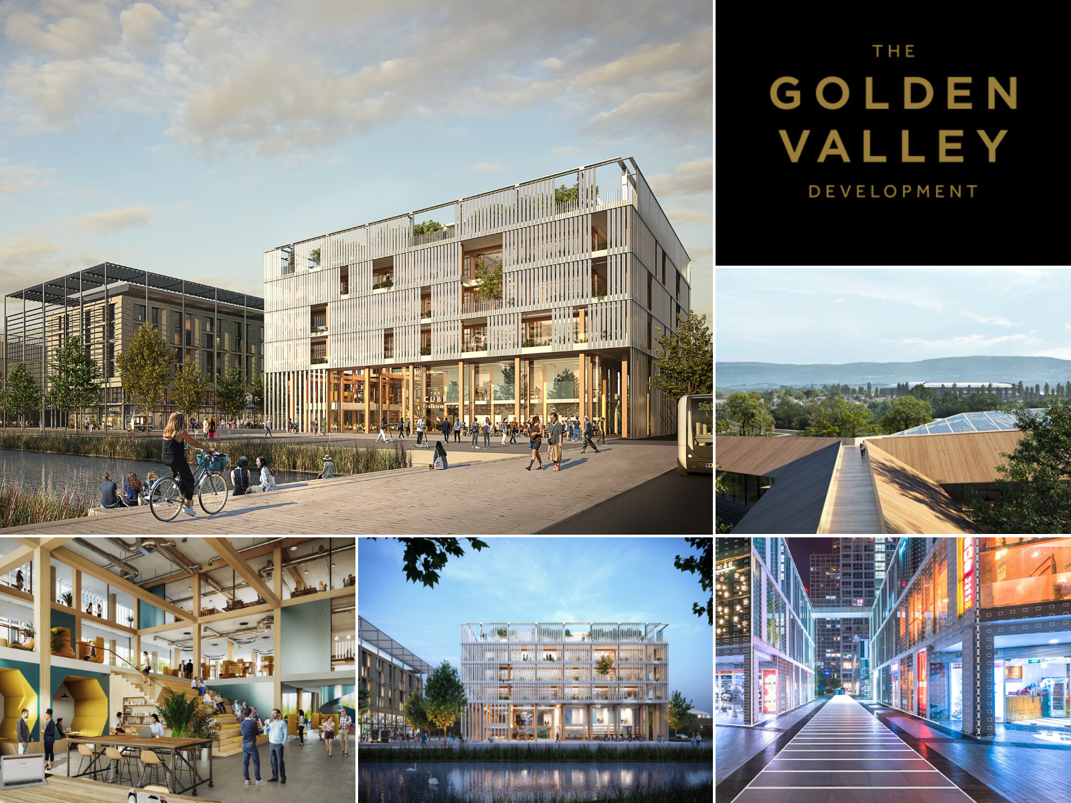
50:50
High skill level jobs
14
13
12
11
10
9
8
7
6
5
4
3
2
1
£ 1 MILLION
£ 500,000
£ 250,000
£ 100,000
£ 50,000
£ 30,000
£ 20,000
£ 10,000
£ 3,000
£ 1,000
£ 400
£ 300
£ 200
£ 100
It is predicted that more jobs in the future will require high skill levels because of:
The increased use of technology
More demands of higher qualifications for higher level jobs
Multi-skilling – Employers need employees with a wide range of skills rather than having employees focus on a single skills area.
Technical and digital jobs are on the rise.
Here in Gloucestershire, cyber is a large growing industry area as we are home to GCHQ and Cheltenham is developing a new cyber park called ‘The Golden Valley Development’ which is attracting cyber companies from all over the globe.
£ 200
LMI CAREERS EDUCATION
In the future it is predicted that more jobs will require:
More manual labour
Less IT skills
A:
B:
Find out what LMI is
Discover why it is important
Learn how you can use it
Find sources of LMI that you can use
Lower skills levels
Higher Skills levels
C:
D:
Question 2

Slide 11
High skill level jobs
50:50
7
6
5
4
3
2
1
£ 1 MILLION
£ 500,000
£ 250,000
£ 100,000
£ 50,000
£ 30,000
£ 20,000
£ 10,000
£ 3,000
£ 1,000
£ 400
£ 300
£ 200
£ 100
It is predicted that more jobs in the future will require high skill levels because of:
The increased use of technology
More demands of higher qualifications for higher level jobs
Multi-skilling – Employers need employees with a wide range of skills rather than having employees focus on a single skills area.
Technical and digital jobs are on the rise.
Here in Gloucestershire, cyber is a large growing industry area as we are home to GCHQ and Cheltenham is developing a new cyber park called ‘The Golden Valley Development’ which is attracting cyber companies from all over the globe.
Question 3
£ 300
LMI CAREERS EDUCATION
In the future it is predicted that more jobs will require:
More manual labour
Less IT skills
A:
B:
Find out what LMI is
Discover why it is important
Learn how you can use it
Find sources of LMI that you can use
Lower skills levels
Higher Skills levels
C:
D:

Slide 12
High skill level jobs
50:50
14
13
12
11
10
9
8
7
6
5
4
3
2
1
£ 1 MILLION
£ 500,000
£ 250,000
£ 100,000
£ 50,000
£ 30,000
£ 20,000
£ 10,000
£ 3,000
£ 1,000
£ 400
£ 300
£ 200
£ 100
It is predicted that more jobs in the future will require high skill levels because of:
The increased use of technology
More demands of higher qualifications for higher level jobs
Multi-skilling – Employers need employees with a wide range of skills rather than having employees focus on a single skills area.
Technical and digital jobs are on the rise.
Here in Gloucestershire, cyber is a large growing industry area as we are home to GCHQ and Cheltenham is developing a new cyber park called ‘The Golden Valley Development’ which is attracting cyber companies from all over the globe.
£ 300
What sector currently employs the most people in Gloucestershire?
Health
Manufacturing
A:
B:
Retail
Accommodation and food services
C:
D:
LMI CAREERS EDUCATION
Question 3
Find out what LMI is
Discover why it is important
Learn how you can use it
Find sources of LMI that you can use

Slide 13
High skill level jobs
50:50
14
13
12
11
10
9
8
7
6
5
4
3
2
1
£ 1 MILLION
£ 500,000
£ 250,000
£ 100,000
£ 50,000
£ 30,000
£ 20,000
£ 10,000
£ 3,000
£ 1,000
£ 400
£ 300
£ 200
£ 100
It is predicted that more jobs in the future will require high skill levels because of:
The increased use of technology
More demands of higher qualifications for higher level jobs
Multi-skilling – Employers need employees with a wide range of skills rather than having employees focus on a single skills area.
Technical and digital jobs are on the rise.
Here in Gloucestershire, cyber is a large growing industry area as we are home to GCHQ and Cheltenham is developing a new cyber park called ‘The Golden Valley Development’ which is attracting cyber companies from all over the globe.
£ 300
What sector currently employs the most people in Gloucestershire?
Health
Manufacturing
A:
B:
Retail
Accommodation and food services
C:
D:
LMI CAREERS EDUCATION
Question 3
Find out what LMI is
Discover why it is important
Learn how you can use it
Find sources of LMI that you can use

Slide 14
50:50
Job sectors in
Gloucestershire
Industry | Employment numbers | % of total
Health | 43,000 | 14.0
Manufacturing | 32,000 | 10.4
Retail | 29,000 | 9.4
Accommodation & food services | 29,000 | 9.4
Education | 26,000 | 8.5
Professional, scientific & technical | 23,000 | 7.5
Business administration & support services | 21,000 | 6.8
Construction | 16,000 | 5.2
Information & communication | 12,000 | 3.9
Transport & storage (inc postal) | 11,000 | 3.6
Arts, entertainment, recreation & other services | 11,000 | 3.6
Wholesale | 10,000 | 3.3
Agriculture, forestry & fishing | 9,000 | 2.9
Financial & insurance | 9,000 | 2.9
Public administration & defence | 9,000 | 2.9
Motor trades | 7,000 | 2.3
Mining, quarrying & utilities | 6,000 | 2.0
Property | 5,000 | 1.6
14
13
12
11
10
9
8
7
6
5
4
3
2
1
£ 1 MILLION
£ 500,000
£ 250,000
£ 100,000
£ 50,000
£ 30,000
£ 20,000
£ 10,000
£ 3,000
£ 1,000
£ 400
£ 300
£ 200
£ 100
This table shows the number of people employed by broad industrial group in Gloucestershire, using the latest 2021 data.
(2022 data won’t be released until Sept/Oct 2023)
The table is sorted on the % of total column, largest to smallest.
Health, Manufacturing and Retail make up the top three sectors.
LMI CAREERS EDUCATION
Question 3
Find out what LMI is
Discover why it is important
Learn how you can use it
Find sources of LMI that you can use
£ 300
What sector currently employs the most people in Gloucestershire?
Health
Manufacturing
A:
B:
Retail
Accommodation and food services
C:
D:

Slide 15
Industry | Employment numbers | % of total
Health | 43,000 | 14.0
Manufacturing | 32,000 | 10.4
Retail | 29,000 | 9.4
Accommodation & food services | 29,000 | 9.4
Education | 26,000 | 8.5
Professional, scientific & technical | 23,000 | 7.5
Business administration & support services | 21,000 | 6.8
Construction | 16,000 | 5.2
Information & communication | 12,000 | 3.9
Transport & storage (inc postal) | 11,000 | 3.6
Arts, entertainment, recreation & other services | 11,000 | 3.6
Wholesale | 10,000 | 3.3
Agriculture, forestry & fishing | 9,000 | 2.9
Financial & insurance | 9,000 | 2.9
Public administration & defence | 9,000 | 2.9
Motor trades | 7,000 | 2.3
Mining, quarrying & utilities | 6,000 | 2.0
Property | 5,000 | 1.6
Job sectors in
Gloucestershire
50:50
7
6
5
4
3
2
1
£ 1 MILLION
£ 500,000
£ 250,000
£ 100,000
£ 50,000
£ 30,000
£ 20,000
£ 10,000
£ 3,000
£ 1,000
£ 400
£ 300
£ 200
£ 100
This table shows the number of people employed by broad industrial group in Gloucestershire, using the latest 2021 data.
(2022 data won’t be released until Sept/Oct 2023)
The table is sorted on the % of total column, largest to smallest.
Health, Manufacturing and Retail make up the top three sectors.
Question 4
LMI CAREERS EDUCATION
Find out what LMI is
Discover why it is important
Learn how you can use it
Find sources of LMI that you can use
£ 300
What sector currently employs the most people in Gloucestershire?
Health
Manufacturing
A:
B:
Retail
Accommodation and food services
C:
D:

Slide 16
Industry | Employment numbers | % of total
Health | 43,000 | 14.0
Manufacturing | 32,000 | 10.4
Retail | 29,000 | 9.4
Accommodation & food services | 29,000 | 9.4
Education | 26,000 | 8.5
Professional, scientific & technical | 23,000 | 7.5
Business administration & support services | 21,000 | 6.8
Construction | 16,000 | 5.2
Information & communication | 12,000 | 3.9
Transport & storage (inc postal) | 11,000 | 3.6
Arts, entertainment, recreation & other services | 11,000 | 3.6
Wholesale | 10,000 | 3.3
Agriculture, forestry & fishing | 9,000 | 2.9
Financial & insurance | 9,000 | 2.9
Public administration & defence | 9,000 | 2.9
Motor trades | 7,000 | 2.3
Mining, quarrying & utilities | 6,000 | 2.0
Property | 5,000 | 1.6
Job sectors in
Gloucestershire
50:50
14
13
12
11
10
9
8
7
6
5
4
3
2
1
£ 1 MILLION
£ 500,000
£ 250,000
£ 100,000
£ 50,000
£ 30,000
£ 20,000
£ 10,000
£ 3,000
£ 1,000
£ 400
£ 300
£ 200
£ 100
This table shows the number of people employed by broad industrial group in Gloucestershire, using the latest 2021 data.
(2022 data won’t be released until Sept/Oct 2023)
The table is sorted on the % of total column, largest to smallest.
Health, Manufacturing and Retail make up the top three sectors.
£ 400
During 2022, which sector advertised the highest average salaries?
Energy production and supply
Information and communication
A:
B:
Finance and insurance
Mining and quarrying
C:
D:
Question 4
LMI CAREERS EDUCATION
Find out what LMI is
Discover why it is important
Learn how you can use it
Find sources of LMI that you can use

Slide 17
Industry | Employment numbers | % of total
Health | 43,000 | 14.0
Manufacturing | 32,000 | 10.4
Retail | 29,000 | 9.4
Accommodation & food services | 29,000 | 9.4
Education | 26,000 | 8.5
Professional, scientific & technical | 23,000 | 7.5
Business administration & support services | 21,000 | 6.8
Construction | 16,000 | 5.2
Information & communication | 12,000 | 3.9
Transport & storage (inc postal) | 11,000 | 3.6
Arts, entertainment, recreation & other services | 11,000 | 3.6
Wholesale | 10,000 | 3.3
Agriculture, forestry & fishing | 9,000 | 2.9
Financial & insurance | 9,000 | 2.9
Public administration & defence | 9,000 | 2.9
Motor trades | 7,000 | 2.3
Mining, quarrying & utilities | 6,000 | 2.0
Property | 5,000 | 1.6
Job sectors in
Gloucestershire
50:50
14
13
12
11
10
9
8
7
6
5
4
3
2
1
£ 1 MILLION
£ 500,000
£ 250,000
£ 100,000
£ 50,000
£ 30,000
£ 20,000
£ 10,000
£ 3,000
£ 1,000
£ 400
£ 300
£ 200
£ 100
This table shows the number of people employed by broad industrial group in Gloucestershire, using the latest 2021 data.
(2022 data won’t be released until Sept/Oct 2023)
The table is sorted on the % of total column, largest to smallest.
Health, Manufacturing and Retail make up the top three sectors.
£ 400
During 2022, which sector advertised the highest average salaries?
Energy production and supply
Information and communication
A:
B:
Finance and insurance
Mining and quarrying
C:
D:
Question 4
LMI CAREERS EDUCATION
Find out what LMI is
Discover why it is important
Learn how you can use it
Find sources of LMI that you can use

Slide 18
Industry | Employment numbers | % of total
Health | 43,000 | 14.0
Manufacturing | 32,000 | 10.4
Retail | 29,000 | 9.4
Accommodation & food services | 29,000 | 9.4
Education | 26,000 | 8.5
Professional, scientific & technical | 23,000 | 7.5
Business administration & support services | 21,000 | 6.8
Construction | 16,000 | 5.2
Information & communication | 12,000 | 3.9
Transport & storage (inc postal) | 11,000 | 3.6
Arts, entertainment, recreation & other services | 11,000 | 3.6
Wholesale | 10,000 | 3.3
Agriculture, forestry & fishing | 9,000 | 2.9
Financial & insurance | 9,000 | 2.9
Public administration & defence | 9,000 | 2.9
Motor trades | 7,000 | 2.3
Mining, quarrying & utilities | 6,000 | 2.0
Property | 5,000 | 1.6
Date | Monthly (£) | Annual (£)
Agriculture, forestry and fishing | 1,943 | 24,948
Mining and quarrying | 4,250 | 71,700
Manufacturing | 2,605 | 38,424
Energy production and supply | 3,788 | 55,128
Water supply, sewerage and waste | 2,784 | 37,560
Construction | 2,449 | 35,616
Wholesale and retail; repair of motor vehicles | 1,708 | 26,712
Transportation and storage | 2,482 | 35,892
Accommodation and food service activities | 1,122 | 17,328
Information and communication | 3,506 | 60,096
Finance and insurance | 3,623 | 89,784
Real estate | 2,274 | 35,376
Professional, scientific and technical | 2,827 | 50,652
Administrative and support services | 1,887 | 30,948
Public administration and defence; social security | 2,886 | 37,764
Education | 2,354 | 31,620
Health and social work | 2,084 | 30,576
Arts, entertainment and recreation | 1,472 | 29,016
Other service activities | 1,625 | 25,332
Households and Extraterritorial | 1,056 | 17,556
50:50
Salaries in
Gloucestershire
14
13
12
11
10
9
8
7
6
5
4
3
2
1
£ 1 MILLION
£ 500,000
£ 250,000
£ 100,000
£ 50,000
£ 30,000
£ 20,000
£ 10,000
£ 3,000
£ 1,000
£ 400
£ 300
£ 200
£ 100
According to the ONS Annual Survey of Hours and Earnings in 2022, the average annual salary in Gloucestershire was:
£34,333
Question 4
LMI CAREERS EDUCATION
£ 400
During 2022, which sector advertised the highest average salaries?
Find out what LMI is
Discover why it is important
Learn how you can use it
Find sources of LMI that you can use
Energy production and supply
Information and communication
A:
B:
Finance and insurance
Mining and quarrying
C:
D:

Slide 19
Date | Monthly (£) | Annual (£)
Agriculture, forestry and fishing | 1,943 | 24,948
Mining and quarrying | 4,250 | 71,700
Manufacturing | 2,605 | 38,424
Energy production and supply | 3,788 | 55,128
Water supply, sewerage and waste | 2,784 | 37,560
Construction | 2,449 | 35,616
Wholesale and retail; repair of motor vehicles | 1,708 | 26,712
Transportation and storage | 2,482 | 35,892
Accommodation and food service activities | 1,122 | 17,328
Information and communication | 3,506 | 60,096
Finance and insurance | 3,623 | 89,784
Real estate | 2,274 | 35,376
Professional, scientific and technical | 2,827 | 50,652
Administrative and support services | 1,887 | 30,948
Public administration and defence; social security | 2,886 | 37,764
Education | 2,354 | 31,620
Health and social work | 2,084 | 30,576
Arts, entertainment and recreation | 1,472 | 29,016
Other service activities | 1,625 | 25,332
Households and Extraterritorial | 1,056 | 17,556
Industry | Employment numbers | % of total
Health | 43,000 | 14.0
Manufacturing | 32,000 | 10.4
Retail | 29,000 | 9.4
Accommodation & food services | 29,000 | 9.4
Education | 26,000 | 8.5
Professional, scientific & technical | 23,000 | 7.5
Business administration & support services | 21,000 | 6.8
Construction | 16,000 | 5.2
Information & communication | 12,000 | 3.9
Transport & storage (inc postal) | 11,000 | 3.6
Arts, entertainment, recreation & other services | 11,000 | 3.6
Wholesale | 10,000 | 3.3
Agriculture, forestry & fishing | 9,000 | 2.9
Financial & insurance | 9,000 | 2.9
Public administration & defence | 9,000 | 2.9
Motor trades | 7,000 | 2.3
Mining, quarrying & utilities | 6,000 | 2.0
Property | 5,000 | 1.6
Salaries in
Gloucestershire
50:50
7
6
5
4
3
2
1
£ 1 MILLION
£ 500,000
£ 250,000
£ 100,000
£ 50,000
£ 30,000
£ 20,000
£ 10,000
£ 3,000
£ 1,000
£ 400
£ 300
£ 200
£ 100
According to the ONS Annual Survey of Hours and Earnings in 2022, the average annual salary in Gloucestershire was:
£34,333
Question 5
LMI CAREERS EDUCATION
£ 400
During 2022, which sector advertised the highest average salaries?
Find out what LMI is
Discover why it is important
Learn how you can use it
Find sources of LMI that you can use
Energy production and supply
Information and communication
A:
B:
Finance and insurance
Mining and quarrying
C:
D:

Slide 20
Date | Monthly (£) | Annual (£)
Agriculture, forestry and fishing | 1,943 | 24,948
Mining and quarrying | 4,250 | 71,700
Manufacturing | 2,605 | 38,424
Energy production and supply | 3,788 | 55,128
Water supply, sewerage and waste | 2,784 | 37,560
Construction | 2,449 | 35,616
Wholesale and retail; repair of motor vehicles | 1,708 | 26,712
Transportation and storage | 2,482 | 35,892
Accommodation and food service activities | 1,122 | 17,328
Information and communication | 3,506 | 60,096
Finance and insurance | 3,623 | 89,784
Real estate | 2,274 | 35,376
Professional, scientific and technical | 2,827 | 50,652
Administrative and support services | 1,887 | 30,948
Public administration and defence; social security | 2,886 | 37,764
Education | 2,354 | 31,620
Health and social work | 2,084 | 30,576
Arts, entertainment and recreation | 1,472 | 29,016
Other service activities | 1,625 | 25,332
Households and Extraterritorial | 1,056 | 17,556
Industry | Employment numbers | % of total
Health | 43,000 | 14.0
Manufacturing | 32,000 | 10.4
Retail | 29,000 | 9.4
Accommodation & food services | 29,000 | 9.4
Education | 26,000 | 8.5
Professional, scientific & technical | 23,000 | 7.5
Business administration & support services | 21,000 | 6.8
Construction | 16,000 | 5.2
Information & communication | 12,000 | 3.9
Transport & storage (inc postal) | 11,000 | 3.6
Arts, entertainment, recreation & other services | 11,000 | 3.6
Wholesale | 10,000 | 3.3
Agriculture, forestry & fishing | 9,000 | 2.9
Financial & insurance | 9,000 | 2.9
Public administration & defence | 9,000 | 2.9
Motor trades | 7,000 | 2.3
Mining, quarrying & utilities | 6,000 | 2.0
Property | 5,000 | 1.6
Salaries in
Gloucestershire
50:50
14
13
12
11
10
9
8
7
6
5
4
3
2
1
£ 1 MILLION
£ 500,000
£ 250,000
£ 100,000
£ 50,000
£ 30,000
£ 20,000
£ 10,000
£ 3,000
£ 1,000
£ 400
£ 300
£ 200
£ 100
According to the ONS Annual Survey of Hours and Earnings in 2022, the average annual salary in Gloucestershire was:
£34,333
£ 500
What percentage of people in Gloucestershire are self-employed?
7%
10%
A:
B:
23%
50%
C:
D:
Question 5
LMI CAREERS EDUCATION
Find out what LMI is
Discover why it is important
Learn how you can use it
Find sources of LMI that you can use

Slide 21
Date | Monthly (£) | Annual (£)
Agriculture, forestry and fishing | 1,943 | 24,948
Mining and quarrying | 4,250 | 71,700
Manufacturing | 2,605 | 38,424
Energy production and supply | 3,788 | 55,128
Water supply, sewerage and waste | 2,784 | 37,560
Construction | 2,449 | 35,616
Wholesale and retail; repair of motor vehicles | 1,708 | 26,712
Transportation and storage | 2,482 | 35,892
Accommodation and food service activities | 1,122 | 17,328
Information and communication | 3,506 | 60,096
Finance and insurance | 3,623 | 89,784
Real estate | 2,274 | 35,376
Professional, scientific and technical | 2,827 | 50,652
Administrative and support services | 1,887 | 30,948
Public administration and defence; social security | 2,886 | 37,764
Education | 2,354 | 31,620
Health and social work | 2,084 | 30,576
Arts, entertainment and recreation | 1,472 | 29,016
Other service activities | 1,625 | 25,332
Households and Extraterritorial | 1,056 | 17,556
Industry | Employment numbers | % of total
Health | 43,000 | 14.0
Manufacturing | 32,000 | 10.4
Retail | 29,000 | 9.4
Accommodation & food services | 29,000 | 9.4
Education | 26,000 | 8.5
Professional, scientific & technical | 23,000 | 7.5
Business administration & support services | 21,000 | 6.8
Construction | 16,000 | 5.2
Information & communication | 12,000 | 3.9
Transport & storage (inc postal) | 11,000 | 3.6
Arts, entertainment, recreation & other services | 11,000 | 3.6
Wholesale | 10,000 | 3.3
Agriculture, forestry & fishing | 9,000 | 2.9
Financial & insurance | 9,000 | 2.9
Public administration & defence | 9,000 | 2.9
Motor trades | 7,000 | 2.3
Mining, quarrying & utilities | 6,000 | 2.0
Property | 5,000 | 1.6
Salaries in
Gloucestershire
50:50
14
13
12
11
10
9
8
7
6
5
4
3
2
1
£ 1 MILLION
£ 500,000
£ 250,000
£ 100,000
£ 50,000
£ 30,000
£ 20,000
£ 10,000
£ 3,000
£ 1,000
£ 400
£ 300
£ 200
£ 100
According to the ONS Annual Survey of Hours and Earnings in 2022, the average annual salary in Gloucestershire was:
£34,333
£ 500
What percentage of people in Gloucestershire are self-employed?
7%
10%
A:
B:
23%
50%
C:
D:
Question 5
LMI CAREERS EDUCATION
Find out what LMI is
Discover why it is important
Learn how you can use it
Find sources of LMI that you can use

Slide 22
Date | Monthly (£) | Annual (£)
Agriculture, forestry and fishing | 1,943 | 24,948
Mining and quarrying | 4,250 | 71,700
Manufacturing | 2,605 | 38,424
Energy production and supply | 3,788 | 55,128
Water supply, sewerage and waste | 2,784 | 37,560
Construction | 2,449 | 35,616
Wholesale and retail; repair of motor vehicles | 1,708 | 26,712
Transportation and storage | 2,482 | 35,892
Accommodation and food service activities | 1,122 | 17,328
Information and communication | 3,506 | 60,096
Finance and insurance | 3,623 | 89,784
Real estate | 2,274 | 35,376
Professional, scientific and technical | 2,827 | 50,652
Administrative and support services | 1,887 | 30,948
Public administration and defence; social security | 2,886 | 37,764
Education | 2,354 | 31,620
Health and social work | 2,084 | 30,576
Arts, entertainment and recreation | 1,472 | 29,016
Other service activities | 1,625 | 25,332
Households and Extraterritorial | 1,056 | 17,556
Industry | Employment numbers | % of total
Health | 43,000 | 14.0
Manufacturing | 32,000 | 10.4
Retail | 29,000 | 9.4
Accommodation & food services | 29,000 | 9.4
Education | 26,000 | 8.5
Professional, scientific & technical | 23,000 | 7.5
Business administration & support services | 21,000 | 6.8
Construction | 16,000 | 5.2
Information & communication | 12,000 | 3.9
Transport & storage (inc postal) | 11,000 | 3.6
Arts, entertainment, recreation & other services | 11,000 | 3.6
Wholesale | 10,000 | 3.3
Agriculture, forestry & fishing | 9,000 | 2.9
Financial & insurance | 9,000 | 2.9
Public administration & defence | 9,000 | 2.9
Motor trades | 7,000 | 2.3
Mining, quarrying & utilities | 6,000 | 2.0
Property | 5,000 | 1.6
50:50
How many people are self-employed
In Gloucestershire?
14
13
12
11
10
9
8
7
6
5
4
3
2
1
£ 1 MILLION
£ 500,000
£ 250,000
£ 100,000
£ 50,000
£ 30,000
£ 20,000
£ 10,000
£ 3,000
£ 1,000
£ 400
£ 300
£ 200
£ 100
44,800
people in Gloucestershire are self-employed.
The percentage of those self-employed in Gloucestershire is slightly higher than the national average at:
9.2%
Question 5
LMI CAREERS EDUCATION
£ 500
What percentage of people in Gloucestershire are self-employed?
Find out what LMI is
Discover why it is important
Learn how you can use it
Find sources of LMI that you can use
7%
10%
A:
B:
23%
50%
C:
D:

Slide 23
Date | Monthly (£) | Annual (£)
Agriculture, forestry and fishing | 1,943 | 24,948
Mining and quarrying | 4,250 | 71,700
Manufacturing | 2,605 | 38,424
Energy production and supply | 3,788 | 55,128
Water supply, sewerage and waste | 2,784 | 37,560
Construction | 2,449 | 35,616
Wholesale and retail; repair of motor vehicles | 1,708 | 26,712
Transportation and storage | 2,482 | 35,892
Accommodation and food service activities | 1,122 | 17,328
Information and communication | 3,506 | 60,096
Finance and insurance | 3,623 | 89,784
Real estate | 2,274 | 35,376
Professional, scientific and technical | 2,827 | 50,652
Administrative and support services | 1,887 | 30,948
Public administration and defence; social security | 2,886 | 37,764
Education | 2,354 | 31,620
Health and social work | 2,084 | 30,576
Arts, entertainment and recreation | 1,472 | 29,016
Other service activities | 1,625 | 25,332
Households and Extraterritorial | 1,056 | 17,556
Industry | Employment numbers | % of total
Health | 43,000 | 14.0
Manufacturing | 32,000 | 10.4
Retail | 29,000 | 9.4
Accommodation & food services | 29,000 | 9.4
Education | 26,000 | 8.5
Professional, scientific & technical | 23,000 | 7.5
Business administration & support services | 21,000 | 6.8
Construction | 16,000 | 5.2
Information & communication | 12,000 | 3.9
Transport & storage (inc postal) | 11,000 | 3.6
Arts, entertainment, recreation & other services | 11,000 | 3.6
Wholesale | 10,000 | 3.3
Agriculture, forestry & fishing | 9,000 | 2.9
Financial & insurance | 9,000 | 2.9
Public administration & defence | 9,000 | 2.9
Motor trades | 7,000 | 2.3
Mining, quarrying & utilities | 6,000 | 2.0
Property | 5,000 | 1.6
How many people are self-employed
In Gloucestershire?
50:50
7
6
5
4
3
2
1
£ 1 MILLION
£ 500,000
£ 250,000
£ 100,000
£ 50,000
£ 30,000
£ 20,000
£ 10,000
£ 3,000
£ 1,000
£ 400
£ 300
£ 200
£ 100
44,800
people in Gloucestershire are self-employed.
The percentage of those self-employed in Gloucestershire is slightly higher than the national average at:
9.2%
Let’s move on to the
big money questions!
Question 6
£ 500
What percentage of people in Gloucestershire are self-employed?
Find out what LMI is
Discover why it is important
Learn how you can use it
Find sources of LMI that you can use
7%
10%
A:
B:
23%
50%
C:
D:

Slide 24
Date | Monthly (£) | Annual (£)
Agriculture, forestry and fishing | 1,943 | 24,948
Mining and quarrying | 4,250 | 71,700
Manufacturing | 2,605 | 38,424
Energy production and supply | 3,788 | 55,128
Water supply, sewerage and waste | 2,784 | 37,560
Construction | 2,449 | 35,616
Wholesale and retail; repair of motor vehicles | 1,708 | 26,712
Transportation and storage | 2,482 | 35,892
Accommodation and food service activities | 1,122 | 17,328
Information and communication | 3,506 | 60,096
Finance and insurance | 3,623 | 89,784
Real estate | 2,274 | 35,376
Professional, scientific and technical | 2,827 | 50,652
Administrative and support services | 1,887 | 30,948
Public administration and defence; social security | 2,886 | 37,764
Education | 2,354 | 31,620
Health and social work | 2,084 | 30,576
Arts, entertainment and recreation | 1,472 | 29,016
Other service activities | 1,625 | 25,332
Households and Extraterritorial | 1,056 | 17,556
Industry | Employment numbers | % of total
Health | 43,000 | 14.0
Manufacturing | 32,000 | 10.4
Retail | 29,000 | 9.4
Accommodation & food services | 29,000 | 9.4
Education | 26,000 | 8.5
Professional, scientific & technical | 23,000 | 7.5
Business administration & support services | 21,000 | 6.8
Construction | 16,000 | 5.2
Information & communication | 12,000 | 3.9
Transport & storage (inc postal) | 11,000 | 3.6
Arts, entertainment, recreation & other services | 11,000 | 3.6
Wholesale | 10,000 | 3.3
Agriculture, forestry & fishing | 9,000 | 2.9
Financial & insurance | 9,000 | 2.9
Public administration & defence | 9,000 | 2.9
Motor trades | 7,000 | 2.3
Mining, quarrying & utilities | 6,000 | 2.0
Property | 5,000 | 1.6
How many people are self-employed
In Gloucestershire?
50:50
7
6
5
4
3
2
1
£ 1 MILLION
£ 500,000
£ 250,000
£ 100,000
£ 50,000
£ 30,000
£ 20,000
£ 10,000
£ 3,000
£ 1,000
£ 400
£ 300
£ 200
£ 100
44,800
people in Gloucestershire are self-employed.
The percentage of those self-employed in Gloucestershire is slightly higher than the national average at:
9.2%
£ 50,000
How many businesses are there in total in Gloucestershire?
15,687
29,405
A:
B:
80,702
40,258
C:
D:
Let’s move on to the
big money questions!
Question 6
Find out what LMI is
Discover why it is important
Learn how you can use it
Find sources of LMI that you can use

Slide 25
Date | Monthly (£) | Annual (£)
Agriculture, forestry and fishing | 1,943 | 24,948
Mining and quarrying | 4,250 | 71,700
Manufacturing | 2,605 | 38,424
Energy production and supply | 3,788 | 55,128
Water supply, sewerage and waste | 2,784 | 37,560
Construction | 2,449 | 35,616
Wholesale and retail; repair of motor vehicles | 1,708 | 26,712
Transportation and storage | 2,482 | 35,892
Accommodation and food service activities | 1,122 | 17,328
Information and communication | 3,506 | 60,096
Finance and insurance | 3,623 | 89,784
Real estate | 2,274 | 35,376
Professional, scientific and technical | 2,827 | 50,652
Administrative and support services | 1,887 | 30,948
Public administration and defence; social security | 2,886 | 37,764
Education | 2,354 | 31,620
Health and social work | 2,084 | 30,576
Arts, entertainment and recreation | 1,472 | 29,016
Other service activities | 1,625 | 25,332
Households and Extraterritorial | 1,056 | 17,556
Industry | Employment numbers | % of total
Health | 43,000 | 14.0
Manufacturing | 32,000 | 10.4
Retail | 29,000 | 9.4
Accommodation & food services | 29,000 | 9.4
Education | 26,000 | 8.5
Professional, scientific & technical | 23,000 | 7.5
Business administration & support services | 21,000 | 6.8
Construction | 16,000 | 5.2
Information & communication | 12,000 | 3.9
Transport & storage (inc postal) | 11,000 | 3.6
Arts, entertainment, recreation & other services | 11,000 | 3.6
Wholesale | 10,000 | 3.3
Agriculture, forestry & fishing | 9,000 | 2.9
Financial & insurance | 9,000 | 2.9
Public administration & defence | 9,000 | 2.9
Motor trades | 7,000 | 2.3
Mining, quarrying & utilities | 6,000 | 2.0
Property | 5,000 | 1.6
How many people are self-employed
In Gloucestershire?
50:50
7
6
5
4
3
2
1
£ 1 MILLION
£ 500,000
£ 250,000
£ 100,000
£ 50,000
£ 30,000
£ 20,000
£ 10,000
£ 3,000
£ 1,000
£ 400
£ 300
£ 200
£ 100
44,800
people in Gloucestershire are self-employed.
The percentage of those self-employed in Gloucestershire is slightly higher than the national average at:
9.2%
£ 50,000
How many businesses are there in total in Gloucestershire?
15,687
29,405
A:
B:
80,702
40,258
C:
D:
Let’s move on to the
big money questions!
Question 6
Find out what LMI is
Discover why it is important
Learn how you can use it
Find sources of LMI that you can use

Slide 26
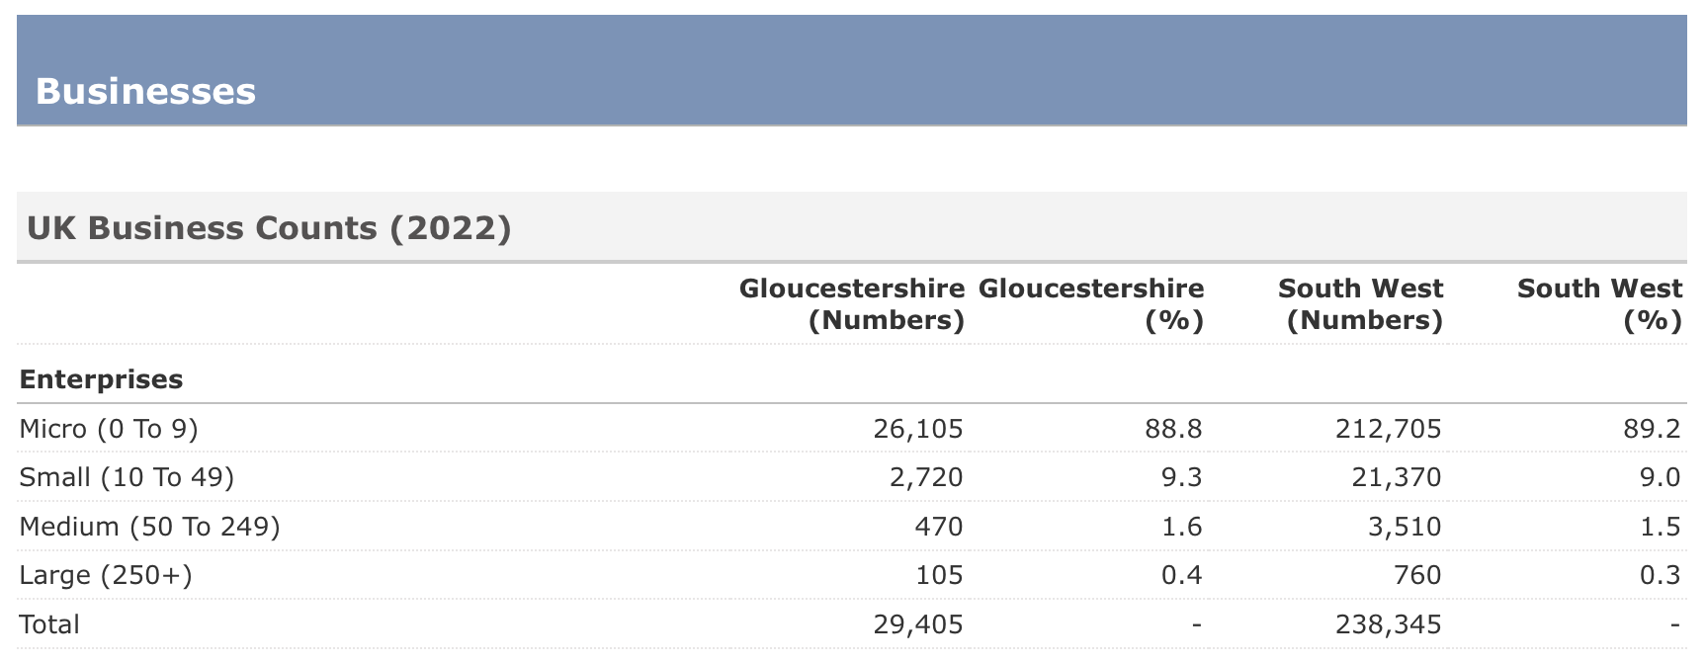
Date | Monthly (£) | Annual (£)
Agriculture, forestry and fishing | 1,943 | 24,948
Mining and quarrying | 4,250 | 71,700
Manufacturing | 2,605 | 38,424
Energy production and supply | 3,788 | 55,128
Water supply, sewerage and waste | 2,784 | 37,560
Construction | 2,449 | 35,616
Wholesale and retail; repair of motor vehicles | 1,708 | 26,712
Transportation and storage | 2,482 | 35,892
Accommodation and food service activities | 1,122 | 17,328
Information and communication | 3,506 | 60,096
Finance and insurance | 3,623 | 89,784
Real estate | 2,274 | 35,376
Professional, scientific and technical | 2,827 | 50,652
Administrative and support services | 1,887 | 30,948
Public administration and defence; social security | 2,886 | 37,764
Education | 2,354 | 31,620
Health and social work | 2,084 | 30,576
Arts, entertainment and recreation | 1,472 | 29,016
Other service activities | 1,625 | 25,332
Households and Extraterritorial | 1,056 | 17,556
Industry | Employment numbers | % of total
Health | 43,000 | 14.0
Manufacturing | 32,000 | 10.4
Retail | 29,000 | 9.4
Accommodation & food services | 29,000 | 9.4
Education | 26,000 | 8.5
Professional, scientific & technical | 23,000 | 7.5
Business administration & support services | 21,000 | 6.8
Construction | 16,000 | 5.2
Information & communication | 12,000 | 3.9
Transport & storage (inc postal) | 11,000 | 3.6
Arts, entertainment, recreation & other services | 11,000 | 3.6
Wholesale | 10,000 | 3.3
Agriculture, forestry & fishing | 9,000 | 2.9
Financial & insurance | 9,000 | 2.9
Public administration & defence | 9,000 | 2.9
Motor trades | 7,000 | 2.3
Mining, quarrying & utilities | 6,000 | 2.0
Property | 5,000 | 1.6
50:50
How many businesses are there
in Gloucestershire?
7
6
5
4
3
2
1
£ 1 MILLION
£ 500,000
£ 250,000
£ 100,000
£ 50,000
£ 30,000
£ 20,000
£ 10,000
£ 3,000
£ 1,000
£ 400
£ 300
£ 200
£ 100
29,405
businesses in the county.
That’s a lot of employers and job opportunities!
Let’s move on to the
big money questions!
Question 6
£ 50,000
How many businesses are there in total in Gloucestershire?
Find out what LMI is
Discover why it is important
Learn how you can use it
Find sources of LMI that you can use
15,687
29,405
A:
B:
80,702
40,258
C:
D:

Slide 27
Date | Monthly (£) | Annual (£)
Agriculture, forestry and fishing | 1,943 | 24,948
Mining and quarrying | 4,250 | 71,700
Manufacturing | 2,605 | 38,424
Energy production and supply | 3,788 | 55,128
Water supply, sewerage and waste | 2,784 | 37,560
Construction | 2,449 | 35,616
Wholesale and retail; repair of motor vehicles | 1,708 | 26,712
Transportation and storage | 2,482 | 35,892
Accommodation and food service activities | 1,122 | 17,328
Information and communication | 3,506 | 60,096
Finance and insurance | 3,623 | 89,784
Real estate | 2,274 | 35,376
Professional, scientific and technical | 2,827 | 50,652
Administrative and support services | 1,887 | 30,948
Public administration and defence; social security | 2,886 | 37,764
Education | 2,354 | 31,620
Health and social work | 2,084 | 30,576
Arts, entertainment and recreation | 1,472 | 29,016
Other service activities | 1,625 | 25,332
Households and Extraterritorial | 1,056 | 17,556
Industry | Employment numbers | % of total
Health | 43,000 | 14.0
Manufacturing | 32,000 | 10.4
Retail | 29,000 | 9.4
Accommodation & food services | 29,000 | 9.4
Education | 26,000 | 8.5
Professional, scientific & technical | 23,000 | 7.5
Business administration & support services | 21,000 | 6.8
Construction | 16,000 | 5.2
Information & communication | 12,000 | 3.9
Transport & storage (inc postal) | 11,000 | 3.6
Arts, entertainment, recreation & other services | 11,000 | 3.6
Wholesale | 10,000 | 3.3
Agriculture, forestry & fishing | 9,000 | 2.9
Financial & insurance | 9,000 | 2.9
Public administration & defence | 9,000 | 2.9
Motor trades | 7,000 | 2.3
Mining, quarrying & utilities | 6,000 | 2.0
Property | 5,000 | 1.6
How many businesses are there
in Gloucestershire?
50:50
7
6
5
4
3
2
1
£ 1 MILLION
£ 500,000
£ 250,000
£ 100,000
£ 50,000
£ 30,000
£ 20,000
£ 10,000
£ 3,000
£ 1,000
£ 400
£ 300
£ 200
£ 100
29,405
businesses in the county.
That’s a lot of employers and job opportunities!
It’s time for the million
pound question!
Question 7
£ 50,000
How many businesses are there in total in Gloucestershire?
Find out what LMI is
Discover why it is important
Learn how you can use it
Find sources of LMI that you can use
15,687
29,405
A:
B:
80,702
40,258
C:
D:

Slide 28
Date | Monthly (£) | Annual (£)
Agriculture, forestry and fishing | 1,943 | 24,948
Mining and quarrying | 4,250 | 71,700
Manufacturing | 2,605 | 38,424
Energy production and supply | 3,788 | 55,128
Water supply, sewerage and waste | 2,784 | 37,560
Construction | 2,449 | 35,616
Wholesale and retail; repair of motor vehicles | 1,708 | 26,712
Transportation and storage | 2,482 | 35,892
Accommodation and food service activities | 1,122 | 17,328
Information and communication | 3,506 | 60,096
Finance and insurance | 3,623 | 89,784
Real estate | 2,274 | 35,376
Professional, scientific and technical | 2,827 | 50,652
Administrative and support services | 1,887 | 30,948
Public administration and defence; social security | 2,886 | 37,764
Education | 2,354 | 31,620
Health and social work | 2,084 | 30,576
Arts, entertainment and recreation | 1,472 | 29,016
Other service activities | 1,625 | 25,332
Households and Extraterritorial | 1,056 | 17,556
Industry | Employment numbers | % of total
Health | 43,000 | 14.0
Manufacturing | 32,000 | 10.4
Retail | 29,000 | 9.4
Accommodation & food services | 29,000 | 9.4
Education | 26,000 | 8.5
Professional, scientific & technical | 23,000 | 7.5
Business administration & support services | 21,000 | 6.8
Construction | 16,000 | 5.2
Information & communication | 12,000 | 3.9
Transport & storage (inc postal) | 11,000 | 3.6
Arts, entertainment, recreation & other services | 11,000 | 3.6
Wholesale | 10,000 | 3.3
Agriculture, forestry & fishing | 9,000 | 2.9
Financial & insurance | 9,000 | 2.9
Public administration & defence | 9,000 | 2.9
Motor trades | 7,000 | 2.3
Mining, quarrying & utilities | 6,000 | 2.0
Property | 5,000 | 1.6
How many businesses are there
in Gloucestershire?
50:50
7
6
5
4
3
2
1
£ 1 MILLION
£ 500,000
£ 250,000
£ 100,000
£ 50,000
£ 30,000
£ 20,000
£ 10,000
£ 3,000
£ 1,000
£ 400
£ 300
£ 200
£ 100
29,405
businesses in the county.
That’s a lot of employers and job opportunities!
£ 1,000,000
Where can you find more information about Labour Market Information and jobs that may be of interest to you?
Career Coach for Gloucestershire website
Careerpilot website
A:
B:
Local job advertisements
All of the above
C:
D:
Find out what LMI is
Discover why it is important
Learn how you can use it
Find sources of LMI that you can use

Slide 29
Date | Monthly (£) | Annual (£)
Agriculture, forestry and fishing | 1,943 | 24,948
Mining and quarrying | 4,250 | 71,700
Manufacturing | 2,605 | 38,424
Energy production and supply | 3,788 | 55,128
Water supply, sewerage and waste | 2,784 | 37,560
Construction | 2,449 | 35,616
Wholesale and retail; repair of motor vehicles | 1,708 | 26,712
Transportation and storage | 2,482 | 35,892
Accommodation and food service activities | 1,122 | 17,328
Information and communication | 3,506 | 60,096
Finance and insurance | 3,623 | 89,784
Real estate | 2,274 | 35,376
Professional, scientific and technical | 2,827 | 50,652
Administrative and support services | 1,887 | 30,948
Public administration and defence; social security | 2,886 | 37,764
Education | 2,354 | 31,620
Health and social work | 2,084 | 30,576
Arts, entertainment and recreation | 1,472 | 29,016
Other service activities | 1,625 | 25,332
Households and Extraterritorial | 1,056 | 17,556
Industry | Employment numbers | % of total
Health | 43,000 | 14.0
Manufacturing | 32,000 | 10.4
Retail | 29,000 | 9.4
Accommodation & food services | 29,000 | 9.4
Education | 26,000 | 8.5
Professional, scientific & technical | 23,000 | 7.5
Business administration & support services | 21,000 | 6.8
Construction | 16,000 | 5.2
Information & communication | 12,000 | 3.9
Transport & storage (inc postal) | 11,000 | 3.6
Arts, entertainment, recreation & other services | 11,000 | 3.6
Wholesale | 10,000 | 3.3
Agriculture, forestry & fishing | 9,000 | 2.9
Financial & insurance | 9,000 | 2.9
Public administration & defence | 9,000 | 2.9
Motor trades | 7,000 | 2.3
Mining, quarrying & utilities | 6,000 | 2.0
Property | 5,000 | 1.6
How many businesses are there
in Gloucestershire?
50:50
7
6
5
4
3
2
1
£ 1 MILLION
£ 500,000
£ 250,000
£ 100,000
£ 50,000
£ 30,000
£ 20,000
£ 10,000
£ 3,000
£ 1,000
£ 400
£ 300
£ 200
£ 100
29,405
businesses in the county.
That’s a lot of employers and job opportunities!
£ 1,000,000
Where can you find more information about Labour Market Information and jobs that may be of interest to you?
It’s time for the million
pound question!
Career Coach for Gloucestershire website
Careerpilot website
A:
B:
Local job advertisements
All of the above
C:
D:
Question 7
Find out what LMI is
Discover why it is important
Learn how you can use it
Find sources of LMI that you can use

Slide 30
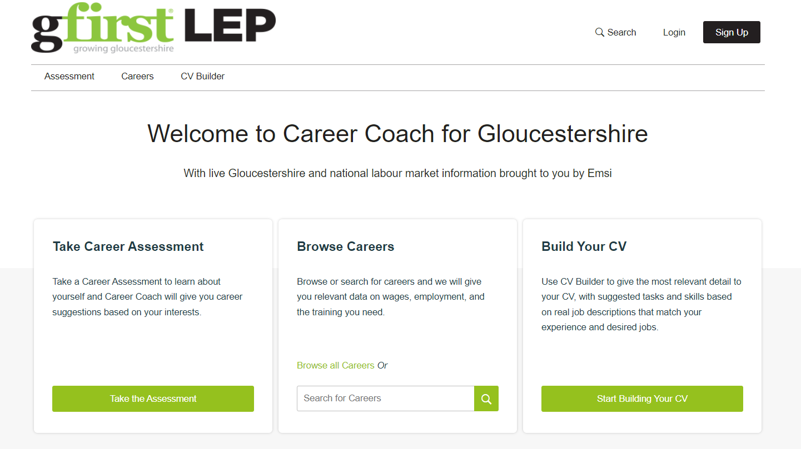
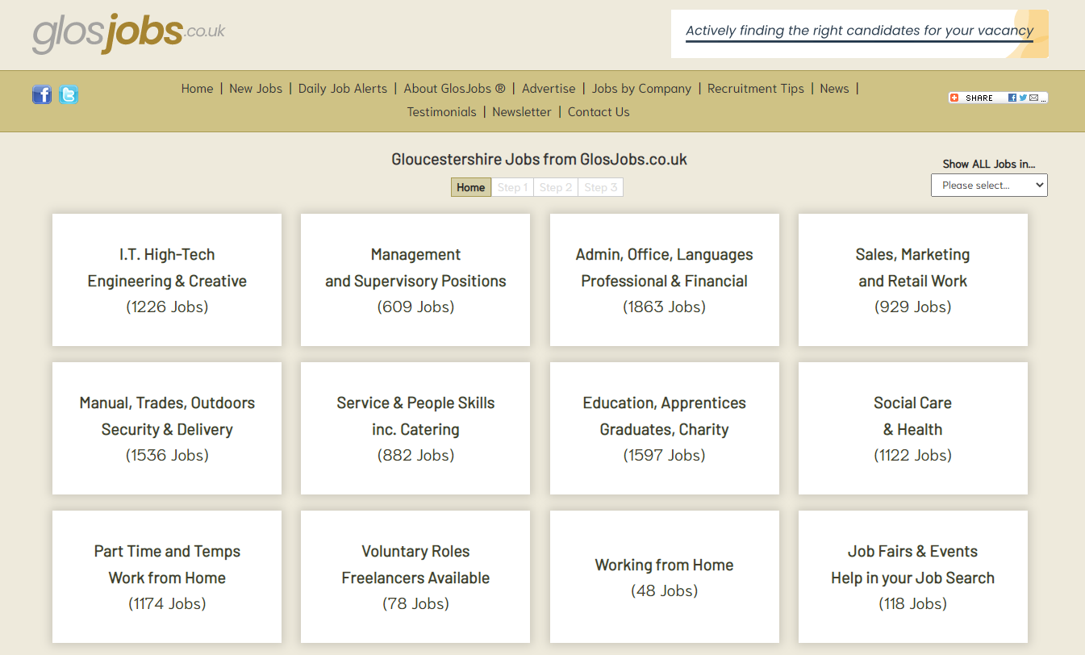
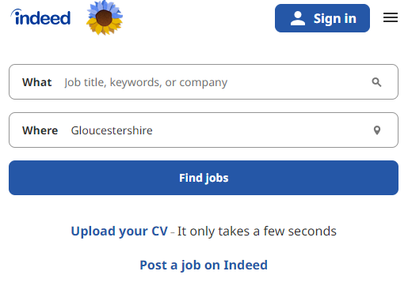
Date | Monthly (£) | Annual (£)
Agriculture, forestry and fishing | 1,943 | 24,948
Mining and quarrying | 4,250 | 71,700
Manufacturing | 2,605 | 38,424
Energy production and supply | 3,788 | 55,128
Water supply, sewerage and waste | 2,784 | 37,560
Construction | 2,449 | 35,616
Wholesale and retail; repair of motor vehicles | 1,708 | 26,712
Transportation and storage | 2,482 | 35,892
Accommodation and food service activities | 1,122 | 17,328
Information and communication | 3,506 | 60,096
Finance and insurance | 3,623 | 89,784
Real estate | 2,274 | 35,376
Professional, scientific and technical | 2,827 | 50,652
Administrative and support services | 1,887 | 30,948
Public administration and defence; social security | 2,886 | 37,764
Education | 2,354 | 31,620
Health and social work | 2,084 | 30,576
Arts, entertainment and recreation | 1,472 | 29,016
Other service activities | 1,625 | 25,332
Households and Extraterritorial | 1,056 | 17,556
Industry | Employment numbers | % of total
Health | 43,000 | 14.0
Manufacturing | 32,000 | 10.4
Retail | 29,000 | 9.4
Accommodation & food services | 29,000 | 9.4
Education | 26,000 | 8.5
Professional, scientific & technical | 23,000 | 7.5
Business administration & support services | 21,000 | 6.8
Construction | 16,000 | 5.2
Information & communication | 12,000 | 3.9
Transport & storage (inc postal) | 11,000 | 3.6
Arts, entertainment, recreation & other services | 11,000 | 3.6
Wholesale | 10,000 | 3.3
Agriculture, forestry & fishing | 9,000 | 2.9
Financial & insurance | 9,000 | 2.9
Public administration & defence | 9,000 | 2.9
Motor trades | 7,000 | 2.3
Mining, quarrying & utilities | 6,000 | 2.0
Property | 5,000 | 1.6
How many businesses are there
in Gloucestershire?
50:50
7
6
5
4
3
2
1
£ 1 MILLION
£ 500,000
£ 250,000
£ 100,000
£ 50,000
£ 30,000
£ 20,000
£ 10,000
£ 3,000
£ 1,000
£ 400
£ 300
£ 200
£ 100
29,405
businesses in the county.
That’s a lot of employers and job opportunities!
Question 7
£ 1,000,000
Where can you find more information about Labour Market Information and jobs that may be of interest to you?
It’s time for the million
pound question!
Find out what LMI is
Discover why it is important
Learn how you can use it
Find sources of LMI that you can use
Career Coach for Gloucestershire website
Careerpilot website
A:
B:
Local job advertisements
All of the above
C:
D:

Slide 31
Date | Monthly (£) | Annual (£)
Agriculture, forestry and fishing | 1,943 | 24,948
Mining and quarrying | 4,250 | 71,700
Manufacturing | 2,605 | 38,424
Energy production and supply | 3,788 | 55,128
Water supply, sewerage and waste | 2,784 | 37,560
Construction | 2,449 | 35,616
Wholesale and retail; repair of motor vehicles | 1,708 | 26,712
Transportation and storage | 2,482 | 35,892
Accommodation and food service activities | 1,122 | 17,328
Information and communication | 3,506 | 60,096
Finance and insurance | 3,623 | 89,784
Real estate | 2,274 | 35,376
Professional, scientific and technical | 2,827 | 50,652
Administrative and support services | 1,887 | 30,948
Public administration and defence; social security | 2,886 | 37,764
Education | 2,354 | 31,620
Health and social work | 2,084 | 30,576
Arts, entertainment and recreation | 1,472 | 29,016
Other service activities | 1,625 | 25,332
Households and Extraterritorial | 1,056 | 17,556
Industry | Employment numbers | % of total
Health | 43,000 | 14.0
Manufacturing | 32,000 | 10.4
Retail | 29,000 | 9.4
Accommodation & food services | 29,000 | 9.4
Education | 26,000 | 8.5
Professional, scientific & technical | 23,000 | 7.5
Business administration & support services | 21,000 | 6.8
Construction | 16,000 | 5.2
Information & communication | 12,000 | 3.9
Transport & storage (inc postal) | 11,000 | 3.6
Arts, entertainment, recreation & other services | 11,000 | 3.6
Wholesale | 10,000 | 3.3
Agriculture, forestry & fishing | 9,000 | 2.9
Financial & insurance | 9,000 | 2.9
Public administration & defence | 9,000 | 2.9
Motor trades | 7,000 | 2.3
Mining, quarrying & utilities | 6,000 | 2.0
Property | 5,000 | 1.6
How many businesses are there
in Gloucestershire?
50:50
7
6
5
4
3
2
1
£ 1 MILLION
£ 500,000
£ 250,000
£ 100,000
£ 50,000
£ 30,000
£ 20,000
£ 10,000
£ 3,000
£ 1,000
£ 400
£ 300
£ 200
£ 100
29,405
businesses in the county.
That’s a lot of employers and job opportunities!
Tie break question!
Find out what LMI is
Discover why it is important
Learn how you can use it
Find sources of LMI that you can use
£ 1,000,000
Where can you find more information about Labour Market Information and jobs that may be of interest to you?
It’s time for the million
pound question!
Career Coach for Gloucestershire website
Careerpilot website
A:
B:
Local job advertisements
All of the above
C:
D:

Slide 32
Date | Monthly (£) | Annual (£)
Agriculture, forestry and fishing | 1,943 | 24,948
Mining and quarrying | 4,250 | 71,700
Manufacturing | 2,605 | 38,424
Energy production and supply | 3,788 | 55,128
Water supply, sewerage and waste | 2,784 | 37,560
Construction | 2,449 | 35,616
Wholesale and retail; repair of motor vehicles | 1,708 | 26,712
Transportation and storage | 2,482 | 35,892
Accommodation and food service activities | 1,122 | 17,328
Information and communication | 3,506 | 60,096
Finance and insurance | 3,623 | 89,784
Real estate | 2,274 | 35,376
Professional, scientific and technical | 2,827 | 50,652
Administrative and support services | 1,887 | 30,948
Public administration and defence; social security | 2,886 | 37,764
Education | 2,354 | 31,620
Health and social work | 2,084 | 30,576
Arts, entertainment and recreation | 1,472 | 29,016
Other service activities | 1,625 | 25,332
Households and Extraterritorial | 1,056 | 17,556
Industry | Employment numbers | % of total
Health | 43,000 | 14.0
Manufacturing | 32,000 | 10.4
Retail | 29,000 | 9.4
Accommodation & food services | 29,000 | 9.4
Education | 26,000 | 8.5
Professional, scientific & technical | 23,000 | 7.5
Business administration & support services | 21,000 | 6.8
Construction | 16,000 | 5.2
Information & communication | 12,000 | 3.9
Transport & storage (inc postal) | 11,000 | 3.6
Arts, entertainment, recreation & other services | 11,000 | 3.6
Wholesale | 10,000 | 3.3
Agriculture, forestry & fishing | 9,000 | 2.9
Financial & insurance | 9,000 | 2.9
Public administration & defence | 9,000 | 2.9
Motor trades | 7,000 | 2.3
Mining, quarrying & utilities | 6,000 | 2.0
Property | 5,000 | 1.6
How many businesses are there
in Gloucestershire?
50:50
7
6
5
4
3
2
1
£ 1 MILLION
£ 500,000
£ 250,000
£ 100,000
£ 50,000
£ 30,000
£ 20,000
£ 10,000
£ 3,000
£ 1,000
£ 400
£ 300
£ 200
£ 100
29,405
businesses in the county.
That’s a lot of employers and job opportunities!
How many jobs were advertised in Gloucestershire during 2022? Closest to the exact number wins!
Find out what LMI is
Discover why it is important
Learn how you can use it
Find sources of LMI that you can use
Bonus question!
Career Coach for Gloucestershire website
Careerpilot website
A:
B:
Local job advertisements
All of the above
C:
D:

Slide 33
Date | Monthly (£) | Annual (£)
Agriculture, forestry and fishing | 1,943 | 24,948
Mining and quarrying | 4,250 | 71,700
Manufacturing | 2,605 | 38,424
Energy production and supply | 3,788 | 55,128
Water supply, sewerage and waste | 2,784 | 37,560
Construction | 2,449 | 35,616
Wholesale and retail; repair of motor vehicles | 1,708 | 26,712
Transportation and storage | 2,482 | 35,892
Accommodation and food service activities | 1,122 | 17,328
Information and communication | 3,506 | 60,096
Finance and insurance | 3,623 | 89,784
Real estate | 2,274 | 35,376
Professional, scientific and technical | 2,827 | 50,652
Administrative and support services | 1,887 | 30,948
Public administration and defence; social security | 2,886 | 37,764
Education | 2,354 | 31,620
Health and social work | 2,084 | 30,576
Arts, entertainment and recreation | 1,472 | 29,016
Other service activities | 1,625 | 25,332
Households and Extraterritorial | 1,056 | 17,556
Industry | Employment numbers | % of total
Health | 43,000 | 14.0
Manufacturing | 32,000 | 10.4
Retail | 29,000 | 9.4
Accommodation & food services | 29,000 | 9.4
Education | 26,000 | 8.5
Professional, scientific & technical | 23,000 | 7.5
Business administration & support services | 21,000 | 6.8
Construction | 16,000 | 5.2
Information & communication | 12,000 | 3.9
Transport & storage (inc postal) | 11,000 | 3.6
Arts, entertainment, recreation & other services | 11,000 | 3.6
Wholesale | 10,000 | 3.3
Agriculture, forestry & fishing | 9,000 | 2.9
Financial & insurance | 9,000 | 2.9
Public administration & defence | 9,000 | 2.9
Motor trades | 7,000 | 2.3
Mining, quarrying & utilities | 6,000 | 2.0
Property | 5,000 | 1.6
How many businesses are there
in Gloucestershire?
50:50
7
6
5
4
3
2
1
£ 1 MILLION
£ 500,000
£ 250,000
£ 100,000
£ 50,000
£ 30,000
£ 20,000
£ 10,000
£ 3,000
£ 1,000
£ 400
£ 300
£ 200
£ 100
29,405
businesses in the county.
That’s a lot of employers and job opportunities!
90,468 jobs posted in 2022
70,168 jobs posted in 2021 and 50,538 in 2020
Find out what LMI is
Discover why it is important
Learn how you can use it
Find sources of LMI that you can use
Bonus question!
Career Coach for Gloucestershire website
Careerpilot website
A:
B:
Local job advertisements
All of the above
C:
D:

Slide 34
Date | Monthly (£) | Annual (£)
Agriculture, forestry and fishing | 1,943 | 24,948
Mining and quarrying | 4,250 | 71,700
Manufacturing | 2,605 | 38,424
Energy production and supply | 3,788 | 55,128
Water supply, sewerage and waste | 2,784 | 37,560
Construction | 2,449 | 35,616
Wholesale and retail; repair of motor vehicles | 1,708 | 26,712
Transportation and storage | 2,482 | 35,892
Accommodation and food service activities | 1,122 | 17,328
Information and communication | 3,506 | 60,096
Finance and insurance | 3,623 | 89,784
Real estate | 2,274 | 35,376
Professional, scientific and technical | 2,827 | 50,652
Administrative and support services | 1,887 | 30,948
Public administration and defence; social security | 2,886 | 37,764
Education | 2,354 | 31,620
Health and social work | 2,084 | 30,576
Arts, entertainment and recreation | 1,472 | 29,016
Other service activities | 1,625 | 25,332
Households and Extraterritorial | 1,056 | 17,556
Industry | Employment numbers | % of total
Health | 43,000 | 14.0
Manufacturing | 32,000 | 10.4
Retail | 29,000 | 9.4
Accommodation & food services | 29,000 | 9.4
Education | 26,000 | 8.5
Professional, scientific & technical | 23,000 | 7.5
Business administration & support services | 21,000 | 6.8
Construction | 16,000 | 5.2
Information & communication | 12,000 | 3.9
Transport & storage (inc postal) | 11,000 | 3.6
Arts, entertainment, recreation & other services | 11,000 | 3.6
Wholesale | 10,000 | 3.3
Agriculture, forestry & fishing | 9,000 | 2.9
Financial & insurance | 9,000 | 2.9
Public administration & defence | 9,000 | 2.9
Motor trades | 7,000 | 2.3
Mining, quarrying & utilities | 6,000 | 2.0
Property | 5,000 | 1.6
50:50
7
6
5
4
3
2
1
£ 1 MILLION
£ 500,000
£ 250,000
£ 100,000
£ 50,000
£ 30,000
£ 20,000
£ 10,000
£ 3,000
£ 1,000
£ 400
£ 300
£ 200
£ 100
29,405
businesses in the county.
That’s a lot of employers and job opportunities!
Well Done!
Thanks for playing!
www.skillsportalglos.com/career-coach/
90,468 jobs posted in 2022
It’s time for the million
pound question!
70,168 jobs posted in 2021 and 50,538 in 2020
Well done!
Career Coach for Gloucestershire website
Careerpilot website
A:
B:
Local job advertisements
All of the above
C:
D:

